Slide 1
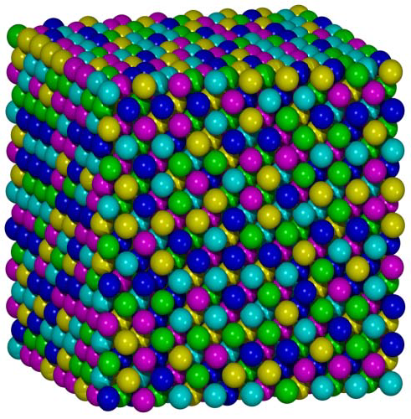
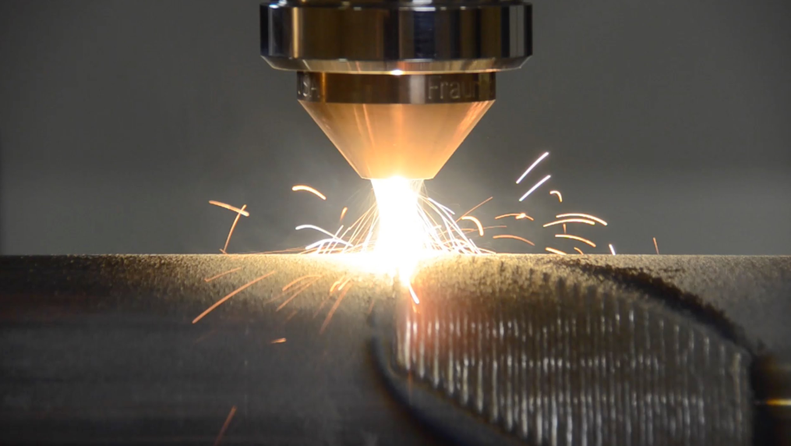
Development of High-Entropy Alloy Coatings (HEAC)
Better, cheaper and safer metallic coating materials, using the novel concept of high-entropy alloying.
Optimized hardness, wear resistance and corrosion resistance, while lowering materials cost and removing unsafe elements
Contribute to priority areas "Utveckla marknadserbjudanden", "Öka materialutvecklingstakten", "Minska miljöpåverkan", and "Öka kompetens och attraktivitet"
Dr. Sheng Guo & Prof. Lars Nyborg
Chalmers University of Technology
Dr. Sven Bengtsson
Höganäs AB

Slide 2
Utveckla tankegången
Conventional coating materials suffer from the conflict between high hardness/wear resistance and corrosion resistance
Conventional coating materials normally contain expensive and environmentally harmful elements like Ni and Co
A breakthrough to develop novel coating materials is now promising using the new high-entropy alloying concept
Pre-study project HEALCOAT shows laser coating of high-entropy alloys is feasible
We now look forward to further developing this project

Slide 3
VAD JAG VILL IDAG….
Do you like our idea?
What is missing?
Can you become our partners for this project?
What can you contribute to this project?
Who will be interested at the new coating material?
Can you suggest some other key applications?
What are we competing with?

