Slide 1
ArcSave® Electromagnetic Stirring for EBT arc furnace
Lidong Teng, ABB Metallurgy, March 4-5, 2015

Slide 2
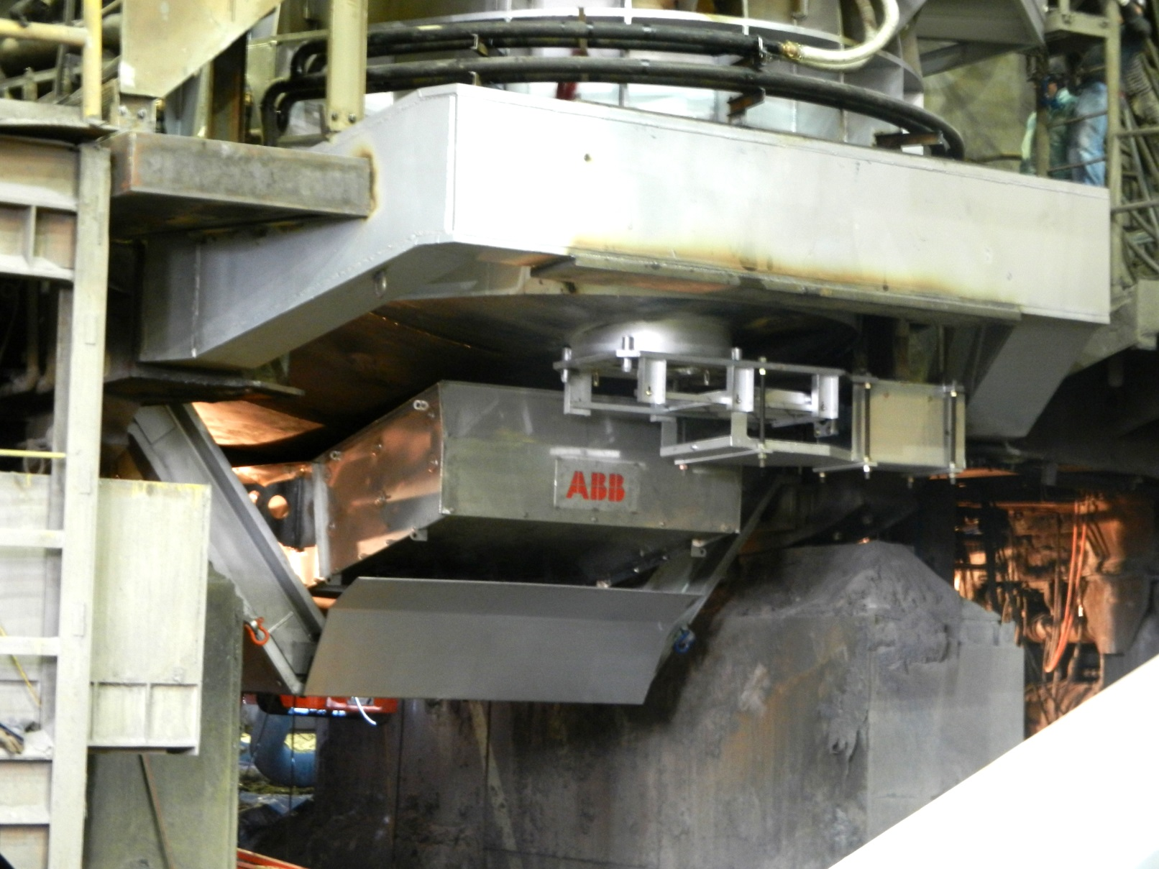
ArcSave® in EAF
Plats för stor bild
4-5 USD/ton saving
Improved safety
Increased productivity
Increased yield +1%
Lidong Teng, Dr.
ABB Metallurgy
Lidong.teng@se.abb.com
Tel: 021-340917

Slide 3
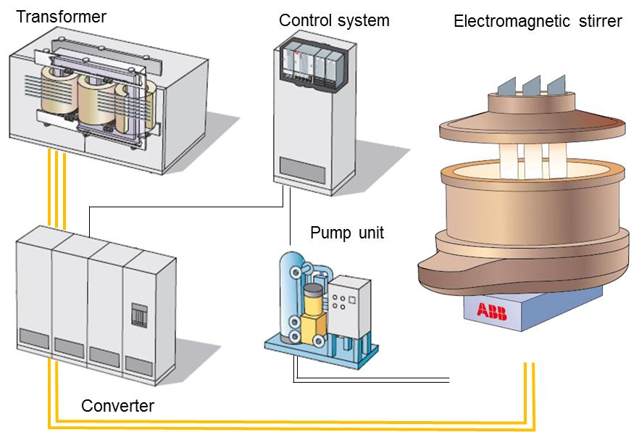
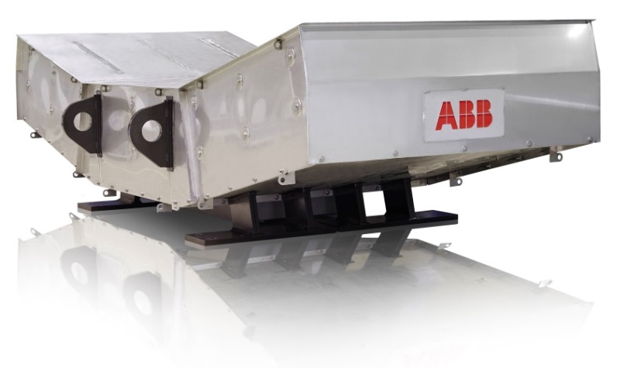
ArcSave Technology – Stirring Patterns
ArcSave gives reliable stirring for the entire EAF melt bath!

Slide 4
ArcSave impact on process
1. Faster scrap melting
Faster scrap, FeCr melting
Less bath surface superheat
Higher heating efficiency
Shorter tap to tap time
2. Strong slag/metal reaction
Homogeneous bath temp.
Efficient slag/steel reaction
Less O in the tapped steel
Fast de-carburization rate
Steel
Slag
3. Higher iron yield
Less FeO in tapped slag
Less scrap in tapped slag
Higher metallic yield in steel
Increased steel yield
4. Safer tapping
Targeted tapping temperature
High EBT open freqency
Delayed vortex formation
Less carryover slag
5. Smooth LF operation
High porous plug opening
Less oxygen activity in slag
Less ferroalloy consumpiton
Less CaO consumption

Slide 5
ArcSave test results (SDI)
Items | Changes
Energy consumption | -5 %
Electrode consumption | -3 %
Iron yield | +0.9 %
Furnace repairing material | -20 %
Tapping temperature | -13 ºC
Carry-over slag | -50%
Tap oxygen | -114 ppm
FeSi | -12 %
CaC₂ | -15 %
Lime (EAF tap and LF additions) | -5 %
Productivity | +6 %
EAF: 90 ton, 100% scrap, carbon steel
Data based on 6 months without ArcSave, 6 months with ArcSave

Slide 6
ArcSave – OSAB test results (preliminary)
Items | Changes
Power consumption | -3~5 %
Electrode consumption | -6 %
Power on time | -4 %
Tap temperature hit ratio | 100 %
Tap weight hit ratio | 91 %
Tapping temperature | -15 ºC
Primary Si | -26%
Lime and dolomite | -9%
N₂ | -100%
EAF: 90 ton, 100% scrap, Stainless steel (3 months without ArcSave, 3 months with ArcSave)

Slide 7
ArcSave Benefits
Productivity +4~6%
Total energy -3~5%
Electrode -3~5%
Yield + 0.7% to 1%
Less alloy and oxygen consumption
Improved safety and process flexibility
Total saving 4~6 $/ton steel

Slide 8
ArcSave in summary
Improved
Yield
Safety &
Flexibility
Cost
Reduction
Increased Productivity
‘‘ArcSave is a technology that is totally invisible but help the melting process make liquid steel safer, quicker and with lower cost !!’’
– Paul Schuler (SDI melt-shop manager)

Slide 9
© ABB Group
February 26, 2015 | Slide 9

